Slide 1

TATA Online Retail Stores Analysis
Tata is a global company that offers a wide range of services, including automotive, consumer retail, steel, and more. It operates successful online retail stores and aims to expand globally through data-driven decisions by its CEO.

Slide 2

As a pleasure, I had the opportunity to meet with the CEO and CMO of this organization, and we spent some time discussing issues that are crucial to the organization's success and using data-driven decisions to drive the organization's sales to the next level. In addition, issues raised by the management and data-driven questions asked were instrumental to this analysis.

Slide 3

METHODOLOGY
The following methodology, unavoidable for the accuracy
and precis result.
Data Collection From Tata Excel Spread Sheet
Performed data wrangling using Power BI Query Editor
Visualization and Insights

Slide 4
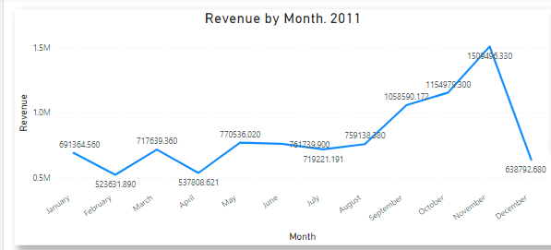
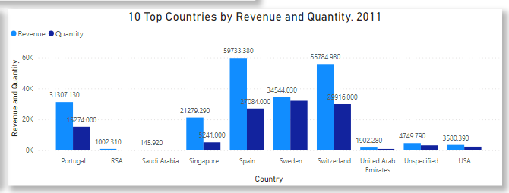
TATA Online Retail Visualization and Insights
At 1,509,496.33, November had the highest Revenue and was 188.27% higher than February, which had the lowest Revenue at 523,631.89.
Across all 12 Month, Revenue ranged from 523,631.89 to 1,509,496.33.
At 59,733.38, Spain had the highest Revenue and was 40,835.70% higher than Saudi Arabia, which had the lowest Revenue at 145.92. • Revenue and total Quantity are positively correlated with each other. • Spain accounted for 27.91% of Revenue. • Revenue and Quantity diverged the most when the Country was Spain, when Revenue were 32,649.38 higher than Quantity

Slide 5
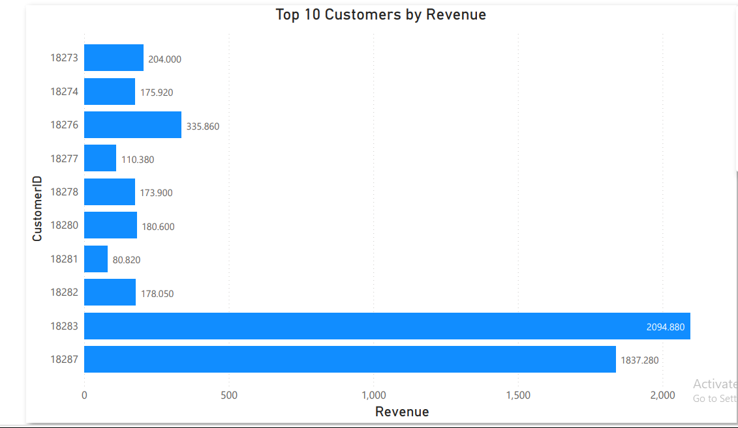
At 2,094.88, 18283 had the highest Revenue and was 2,492.03% higher than 18281, which had the lowest Revenue at 80.82.
18283 accounted for 39.00% of Revenue.
Across all 10CustomerID, Revenue
ranged from 80.82 to 2 094 880

Slide 6
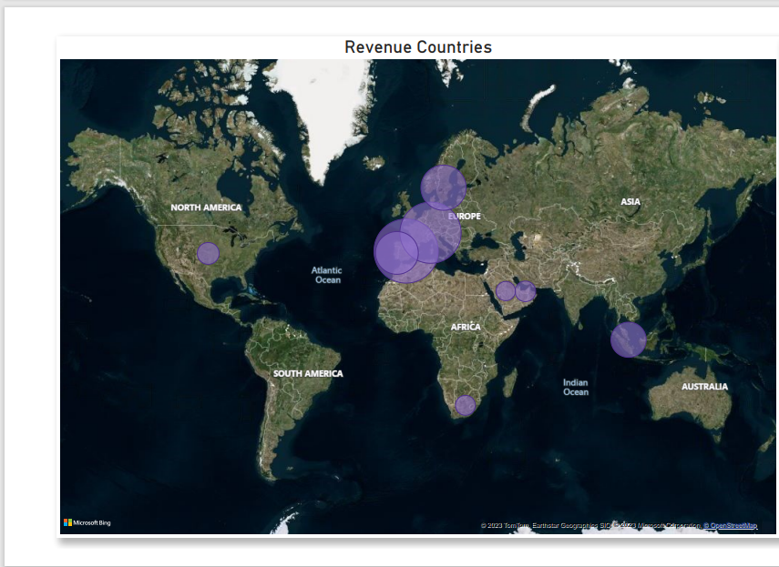
At 59,733.38, Spain had the highest Revenue and was 40,835.70% higher than Saudi Arabia, which had the lowest Revenue at 145.92.
Spain accounted for 27.91% of Revenue.
Across all 10 Country, Revenue ranged from 145.92 to 59,733.38.

Slide 7
CONCLUTION AND RECOMMEDATIONS.
The company experienced sales increase from May to November which played a significant impact on stock depletion. For this reason, aiming to stock products during these periods and engaging in advertising strategies to encourage the customer to make a purchase during these periods would be a good idea
There is a decline in sales after November. There is a need for the company to prepare a promotional strategy to employ after the sales of November
To improve customer relationships, the company should consider providing incentives to its top revenue-generating customers
In every region, there is a unique product that is unique to that region. In order to increase regional sales, the company should investigate the most influential products in each region and promote them.

